Slide 1
Invest in yourself
Advanced Level

Slide 2
What is a job?
Job – an activity through which an individual can earn money
Most people have several jobs during their lifetime
Have you had a job?
What jobs have your family members had?

Slide 3
How do you become qualified for jobs?
Human capital
Transferable skills
Invest
in yourself

Slide 4
What is human capital?
Human capital - the skills, knowledge, and experiences possessed by an individual
How can a person invest in their human capital?

Slide 5
What are transferable skills?
Transferable skills - versatile skills that are applied to personal and professional roles
Creativity
Organization
Cooperation
Listening

Slide 6
Categories of Transferable Skills
Interpersonal
People or soft skills
Presenting
Analytical
Analyze problems and find solutions
Research
Technical
Organization
Specific, hands-on skills
Computer proficiency
Sort data, plan, arrange projects, keep records
Time management
Explanation
Example
What is a transferable skill
you possess in each category?

Slide 7
Developing Transferable Skills Round Robin
As a group identify and record one action to develop the transferable skill listed on the card
When finished, pass the card to the next group
Don’t repeat an action that was listed by another group
Continue until all cards are complete

Slide 8
Creativity
Critical thinking/problem solving
Technology
Organization
Clear communication & teamwork
Take a class, participate in an organization, volunteer
Have a part-time job, participate in a sport, use an electronic time saving tool such as Evernote
Participate in a group project, student organization, take a class, attend a leadership training
Enroll in challenging classes, engage in meaningful discussion, enhance reading and writing skills
Take a class, participate in collaborative online environments, use technology for learning

Slide 9
Investing in your human capital and transferable skills
Develops
A career
Career - lifetime journey of building and applying skills, knowledge, and experiences in paid employment positions

Slide 10
Why develop your career?
Enhance well-being
High well‐being comes from feeling good about one’s life
Careers may contribute to high well-being
Feelings of success
Results in meaningful work
Enjoyable

Slide 11
Why develop your career?
Standard of living
Potential to earn more money
Lifestyle
Level of goods and services you desire
Level of goods and services you currently have

Slide 12
How do you invest in yourself?
Continuing education
Informal training
Formal training
Learning that occurs in daily life
Learn a specific set of skills usually from experts
Networking
Reading
Post-secondary education
Workshops
What type of informal and formal training
are you currently participating in?

Slide 13
Training often results in…
Greater job security
Increased employability
Increase earnings throughout a career
Increased knowledge
Making connections with people
Adding/enhancing skills

Slide 14
Post-secondary education
Formal training with no degree
Become a specialist in an area (certificate or non-certificate)
Some college, no degree
Official degree requirements are not completed
Associate
Two-year degree although time varies
Bachelor’s
Four-year degree although time varies
Prerequisite = high school diploma or passing of GED test

Slide 15
Prerequisite = Bachelor’s degree
Master’s
Average of two or more years of study
Doctorate
Completion time varies but is an average of four or five years
Professional
Special type of advanced degree required by some occupations
Time to complete varies
Having a Master’s degree is a common requirement

Slide 16
Where can post-secondary education occur?
Community colleges
Technical/ vocational schools
Colleges
Universities
Private institutions
Academies

Slide 17
Education pays…
Income Earning Ability
Education
Unemployment

Slide 18
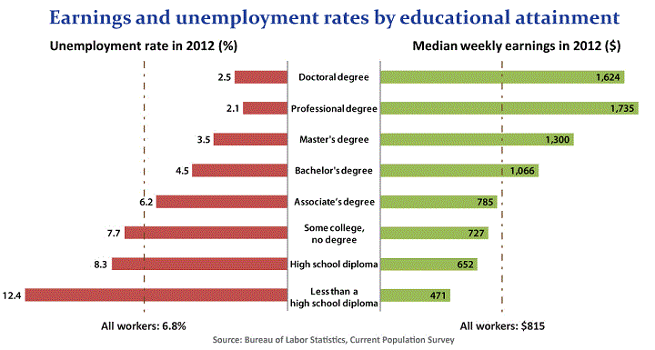

Slide 19
Education Tower
Goal
Challenge
Each group has a different education level with certain skills and limitations
Build the tallest free-standing tower using only the supplies provided

Slide 20
Education Tower
High School Dropout
Can use one hand only, the other must be kept behind their back and all communication must be done nonverbally
High School Graduate
Can use one hand only and the other must be kept behind their back
Associate degree
Have full use of their hands but all communication must be done nonverbally
Bachelor’s degree
Have full use of their hands but the team must designate one person only who can talk; others must communicate nonverbally
Doctorate degree
Have no limitations

Slide 21
Education Tower Discussion
Which group had to work the hardest to build the tower? Why?
Why were some groups more successful than others?
How did the education level relate to the degree of the assigned limitations?
How might a person get the “skills” needed for the opportunity to add to their occupational level and earn a higher income?
How does this activity relate and not relate to real life?

Slide 22
Occupation and Industry
Occupation –
Grouping of jobs that perform similar tasks
Industry –
Group of establishments that produce similar products or provide similar services

Slide 23
Jenny’s Occupation
Accountant
Industry
Manufacturing
Industry
Leisure and Hospitality
Current Job:
Accountant for an electronics company
Potential Job:
Hotel accountant

Slide 24
Occupation
Elementary, Middle, and High School Principals
Occupation
Elementary school teacher
Industry
Education and Health Services
Formal training
Receives a Master’s degree in education
Industry
Education and Health Services
Current Job:
Teaching second grade
Potential Job:
Elementary school principal

Slide 25
Help determine what continuing education to pursue
Jobs
Occupations
Industries

Slide 26
Career Clusters
Career cluster - a grouping of occupations and industries based on the knowledge and skills required
Helps students prepare for employment

Slide 27
Your present self impacts your future self
Invest in human capital today
Future job opportunities that create well-being
How are you currently investing
in your human capital?

Slide 28

Read Anthony’s story

Slide 29
Underline actions Anthony took that contributed to his human capital.
Worked for his dad’s construction company
Played basketball
Volunteered at the Boys and Girls Club
Went to college
Gave campus tours to incoming freshmen
Obtained a Bachelor’s degree in business
Worked for a construction company specializing in commercial building
Worked as a sales representative

Slide 30
Choose two transferable skills and explain what Anthony did to gain those skills.
Circle the transferable skills Anthony has gained.
Discipline
Working for his dad’s construction company
Patience
Working for his dad’s construction company
Presenting
Giving campus tours to incoming freshmen
Communication
Attending college
Construction
Working for construction companies
Teamwork
Playing basketball

Slide 31
Continuing Education
What informal training has Anthony received?
What formal training has
Anthony received?
Working for and observing his dad’s construction company
Bachelor’s degree in business
Volunteering at the Boys and Girls Club
Training for commercial building
Advisory relationship with college advisor
Gave campus tours to incoming freshmen

Slide 32
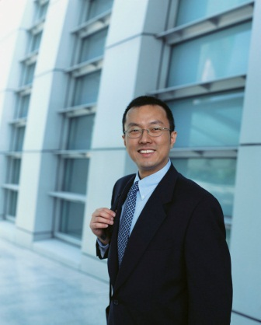
Discussion
How did investing in his human capital help Anthony when the construction business went through a down time?
If Anthony had stayed in the construction business and not completed his degree in Business, what options would he have if he was laid off from his job?
What is one way Anthony can continue his education via formal training?

